Slide 1
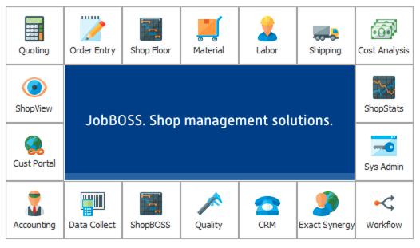
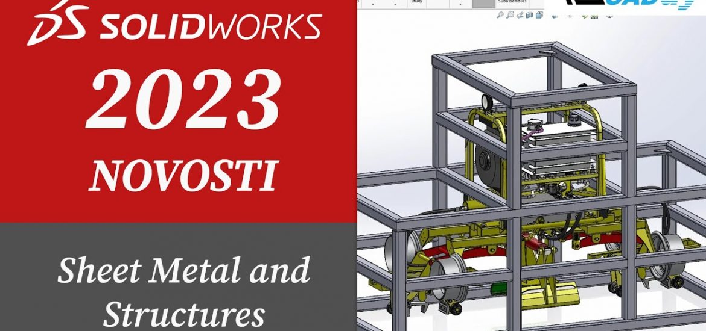
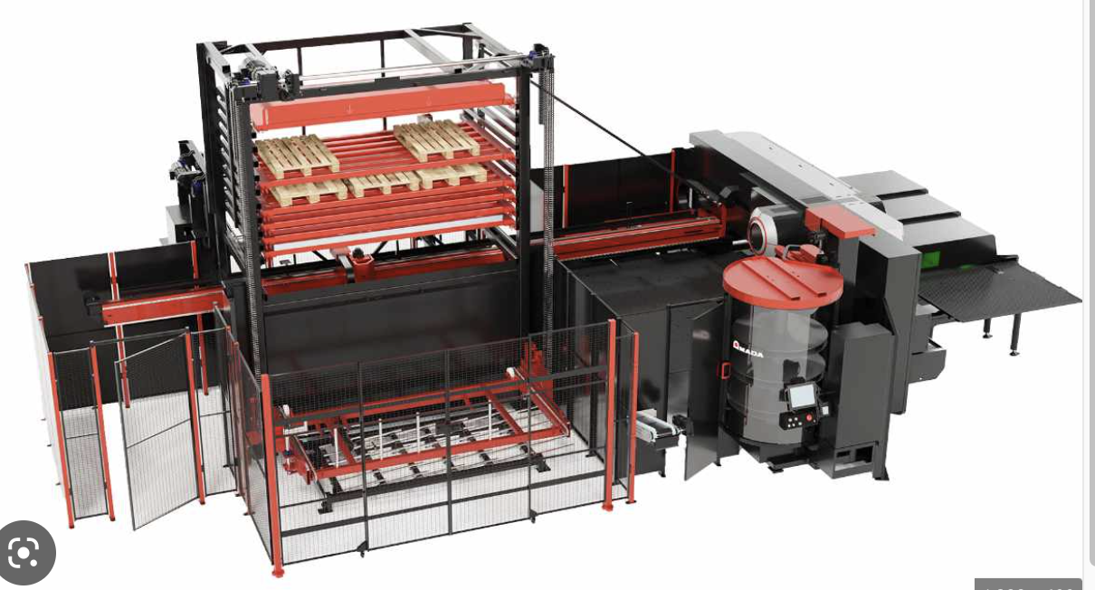
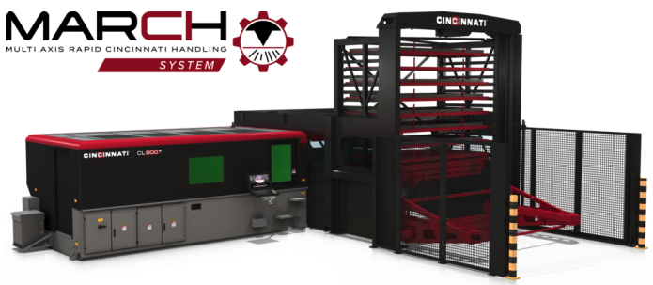
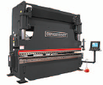
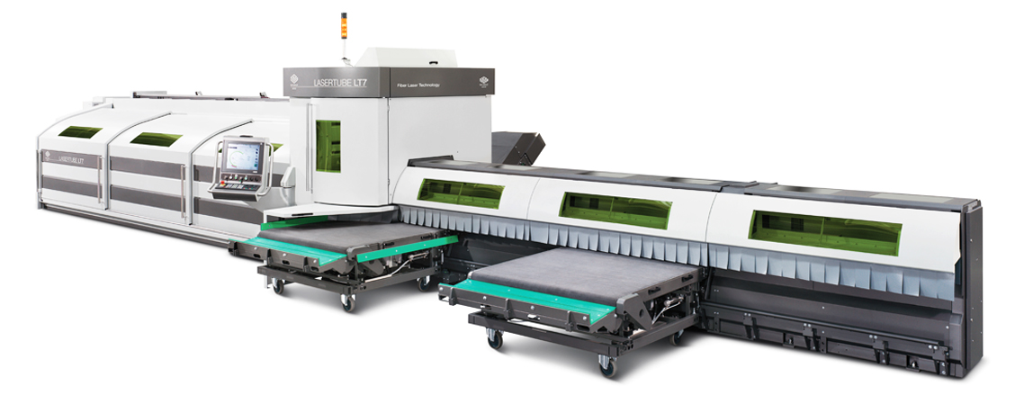
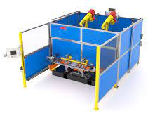
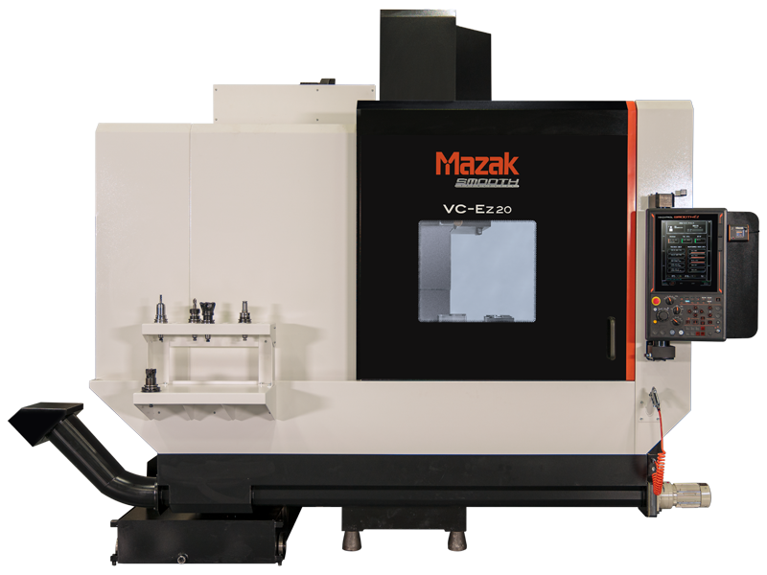
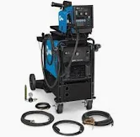
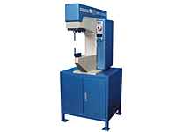
Screenshot 2023-04-12 at 12.21.31 PM
Enterprise Resource Planning
Production Services
Industries Served
We have implemented a proven robust shop management platform for our business processes in ECI-Jobboss.
Flat Laser Cutting
Tube Laser Cutting
Laser / Punch Combo
CNC Mills / Lathes
Deburr/Edge Rounding
Forming
Hardware Insertion
Spot Welding
Mig/Tig Welding
Robotic Welding
Final Assembly
Material Handling
Display & Fixture
Construction Equipment
Medical Equipment
Office Furniture
Railroad
Automotive
Government
Engineering
Powerful 3D CAD tools to assist with design for manufacturing. Our engineers are Certified Professionals in Solidworks.
Outside Services
Powder Coating
E-Coating
& Others
Equipment
Automated CNC Fiber Laser/Punch Combo w/Part Sorting
Automated CNC Laser “Fiber” Cutting
CNC Tube Laser “Fiber” Cutting
Brake Forming
CNC Mills / Lathes
Mig / Tig Welding
Robotic Welding
Spot Welding
Hardware Insertion

Slide 2
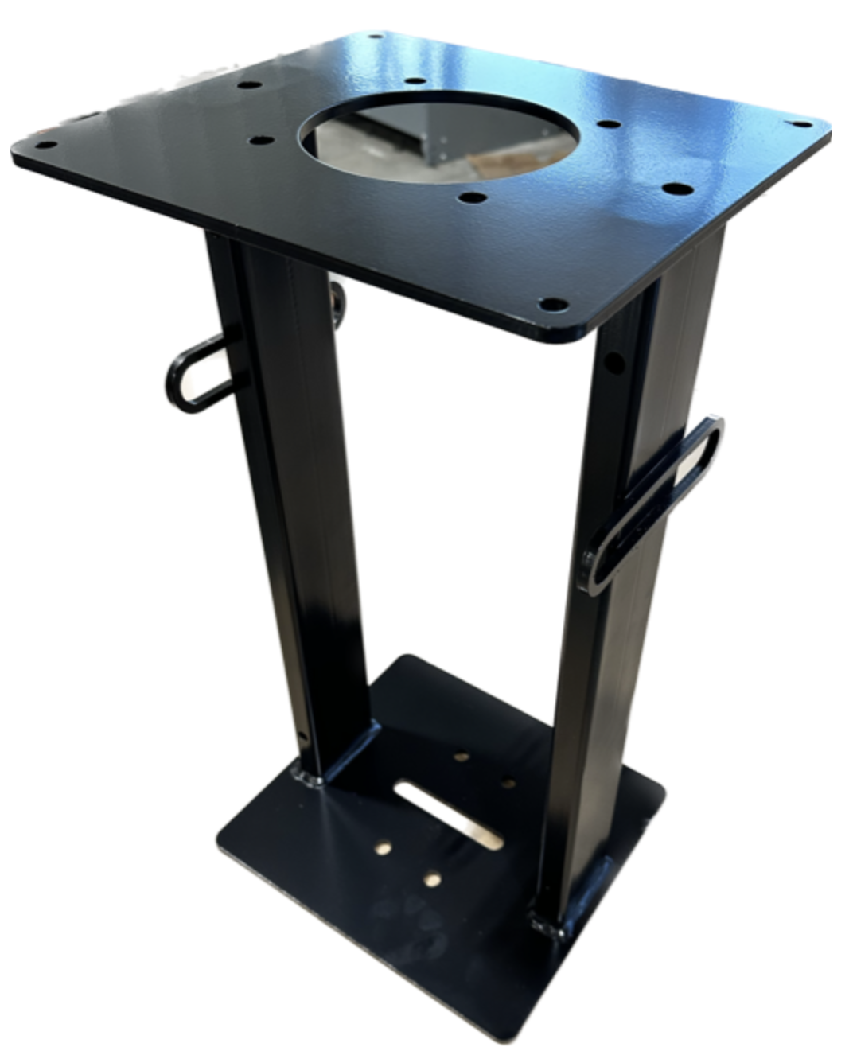
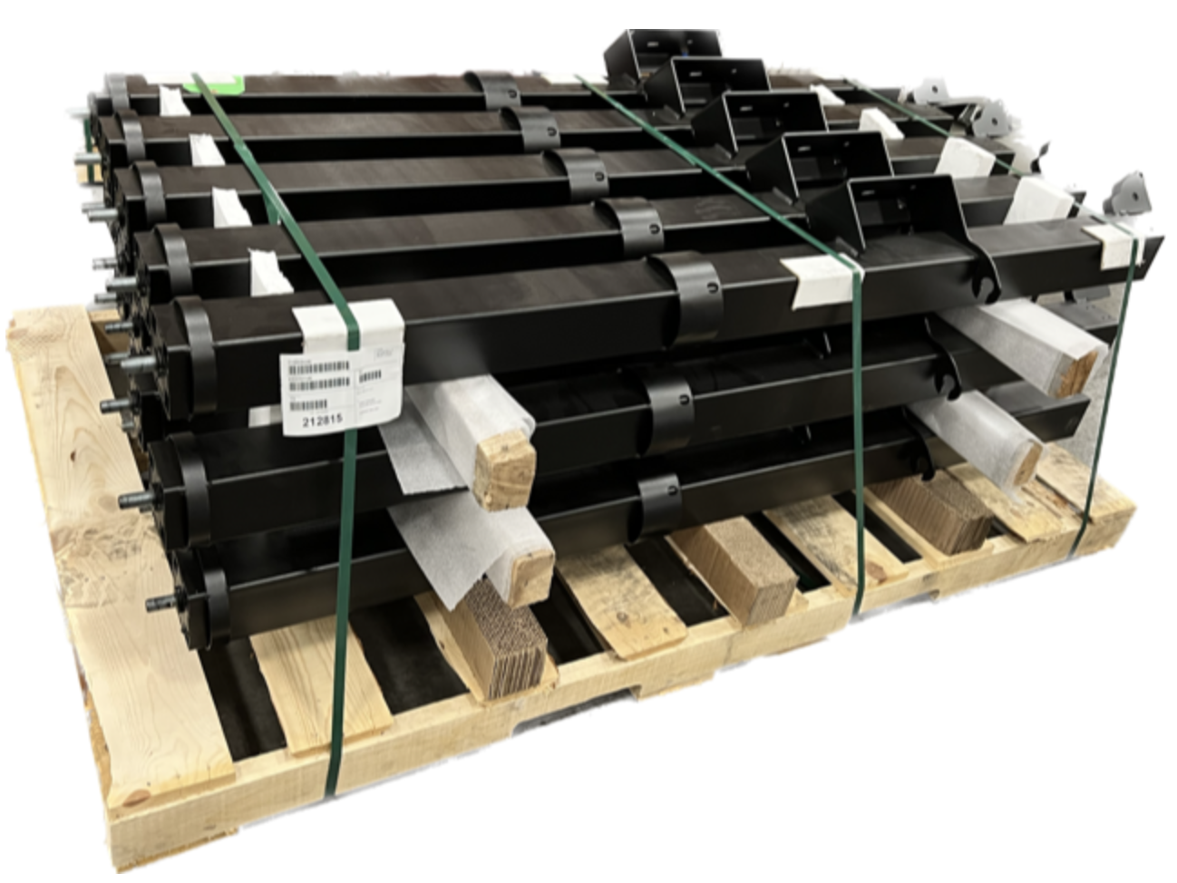
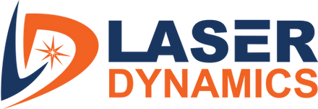
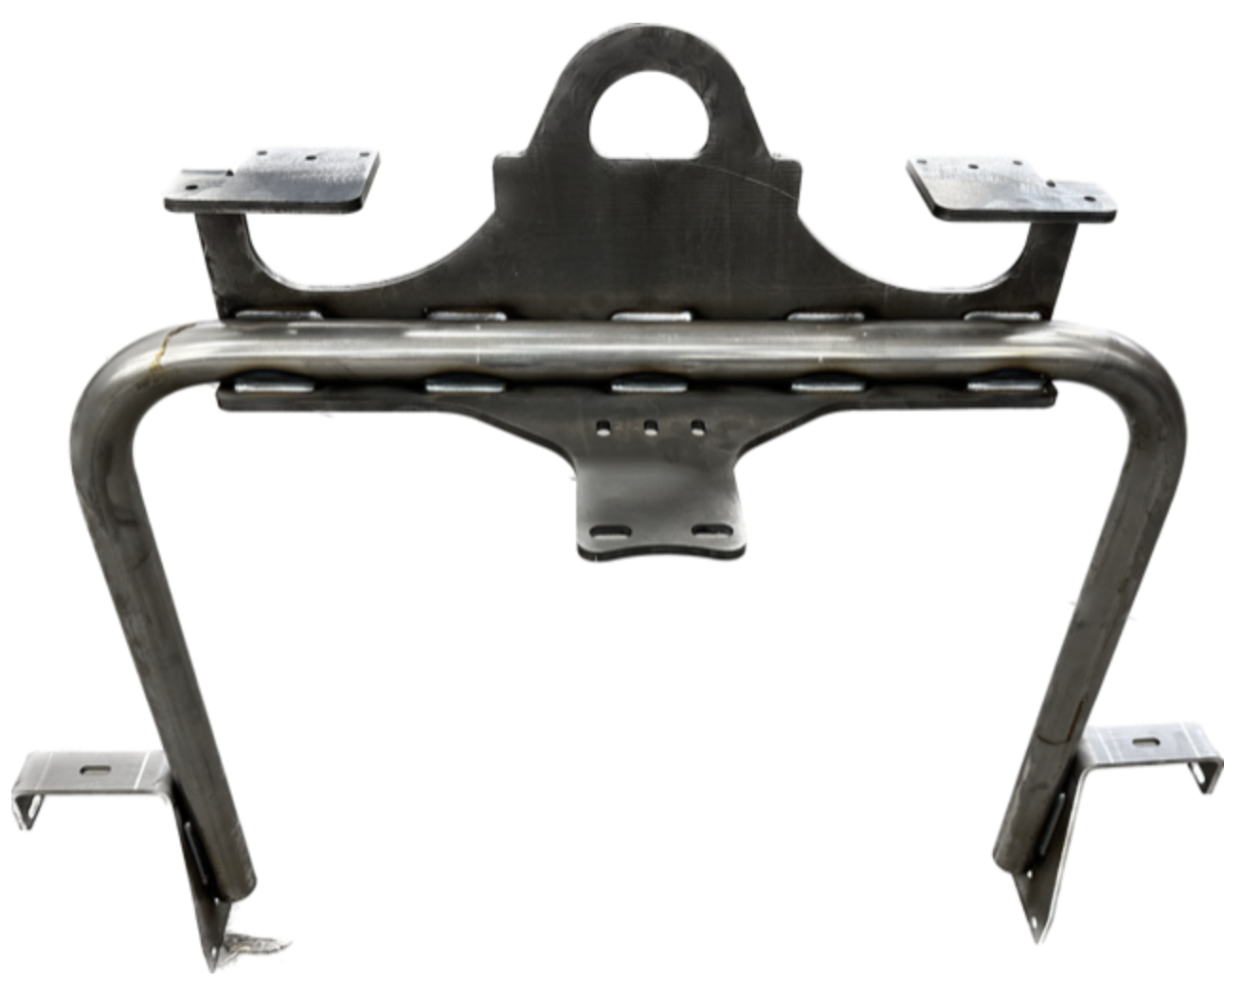
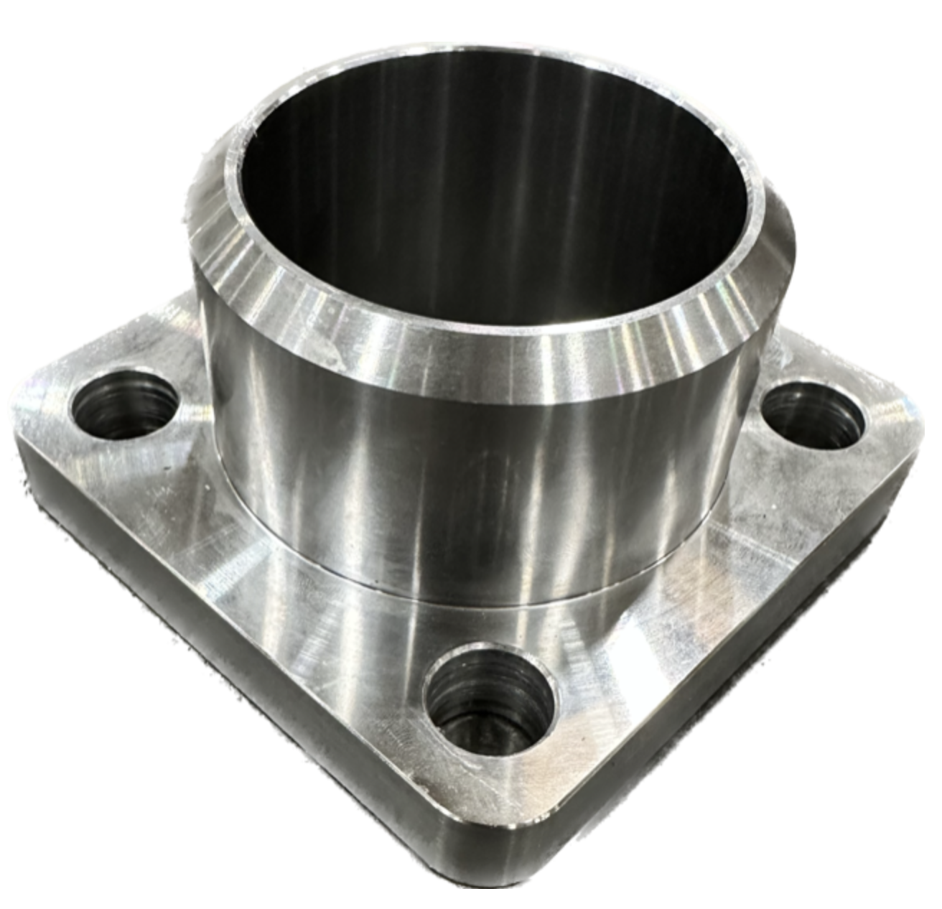
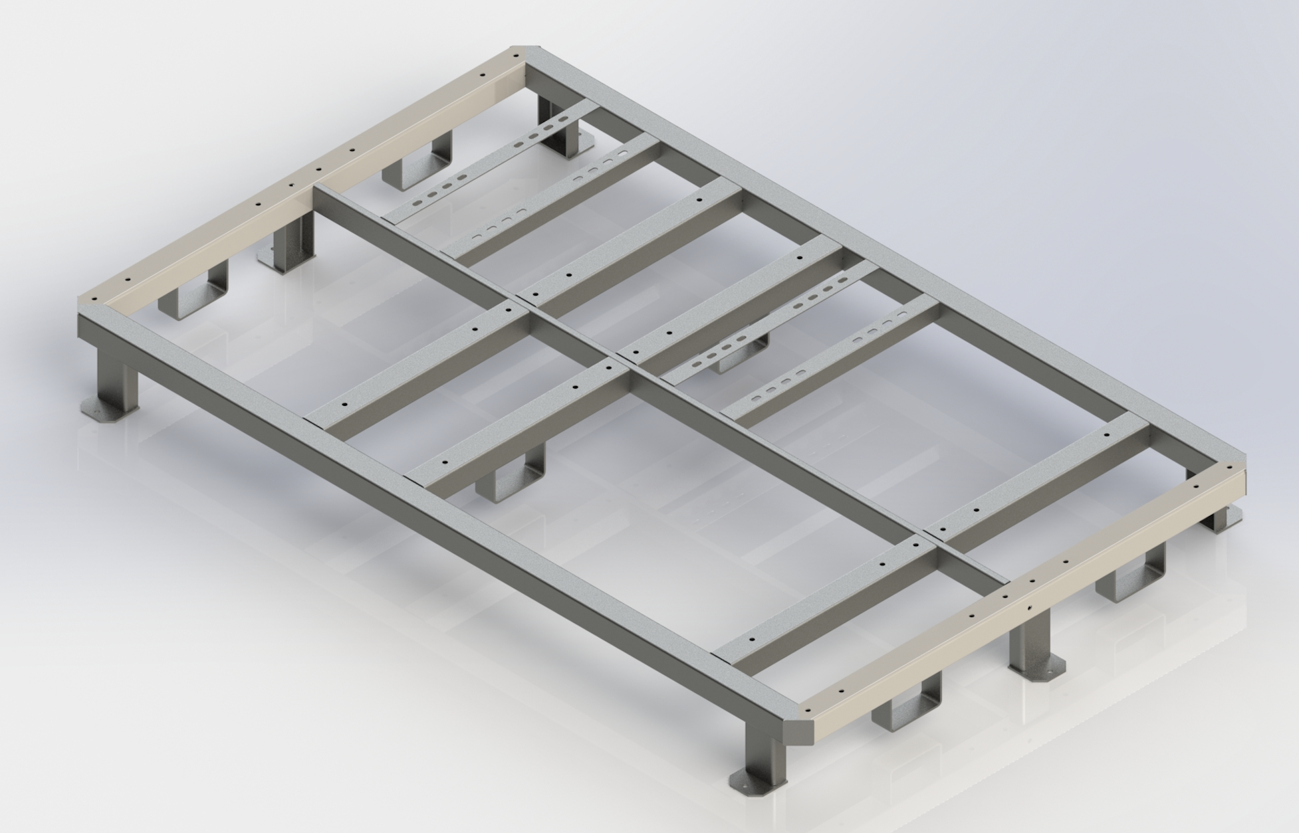
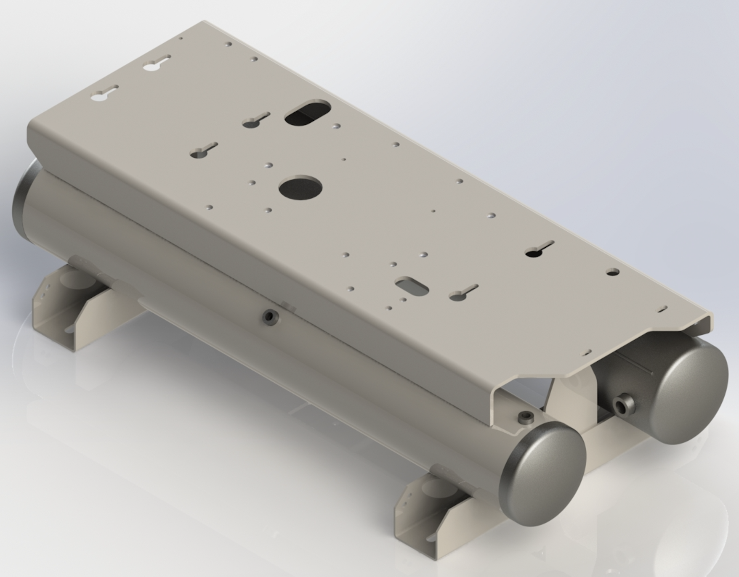
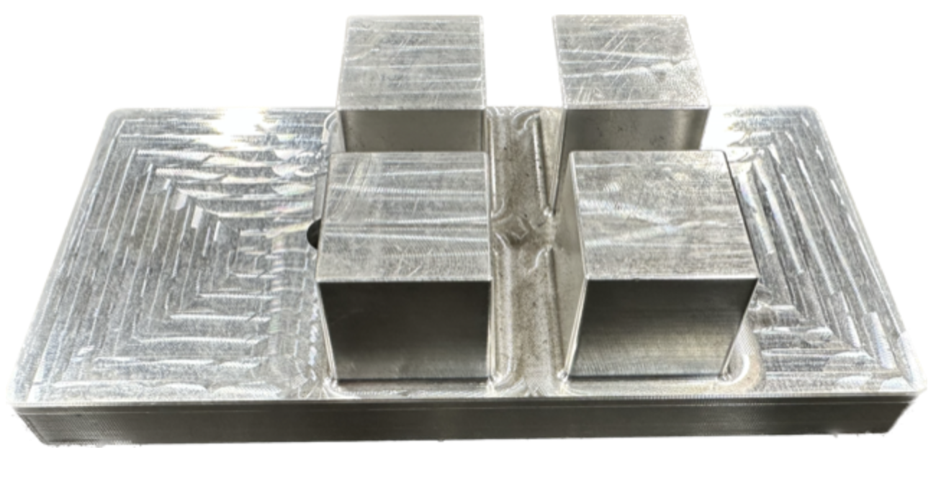
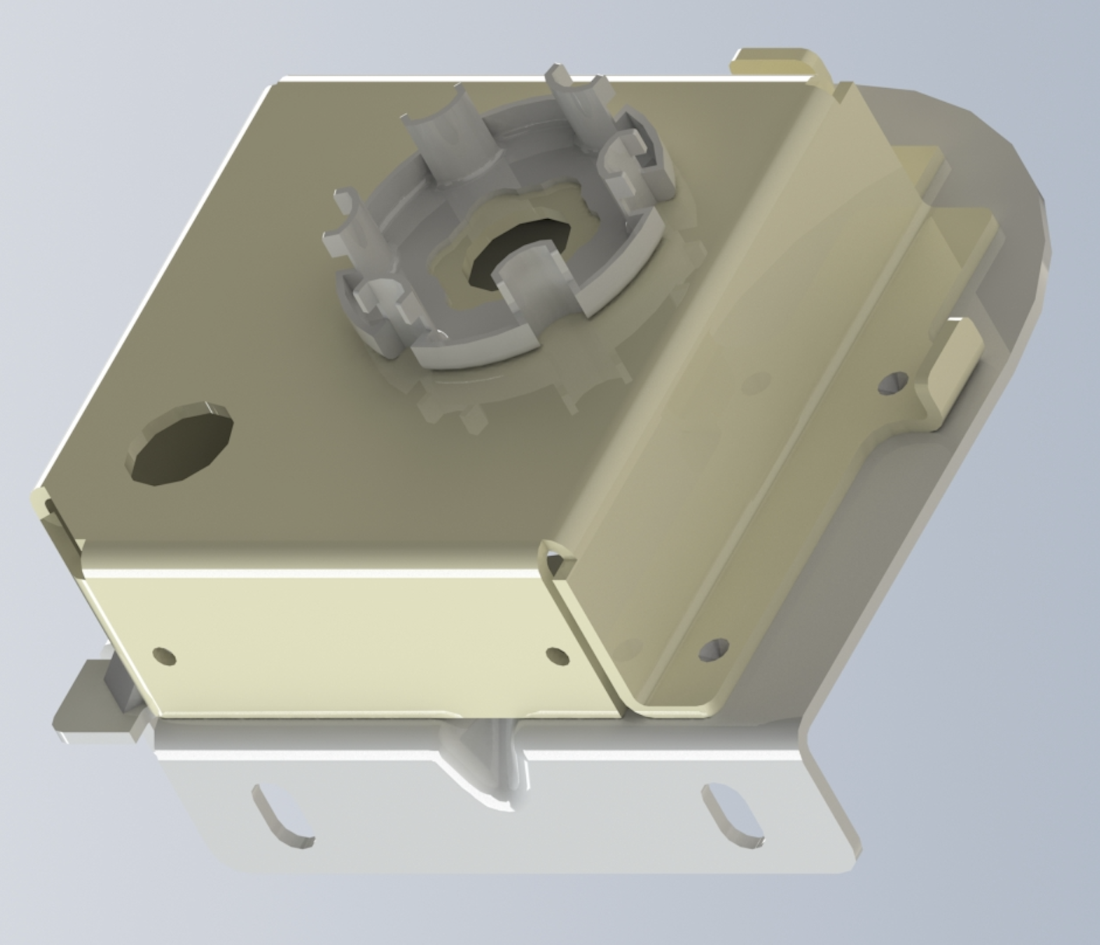
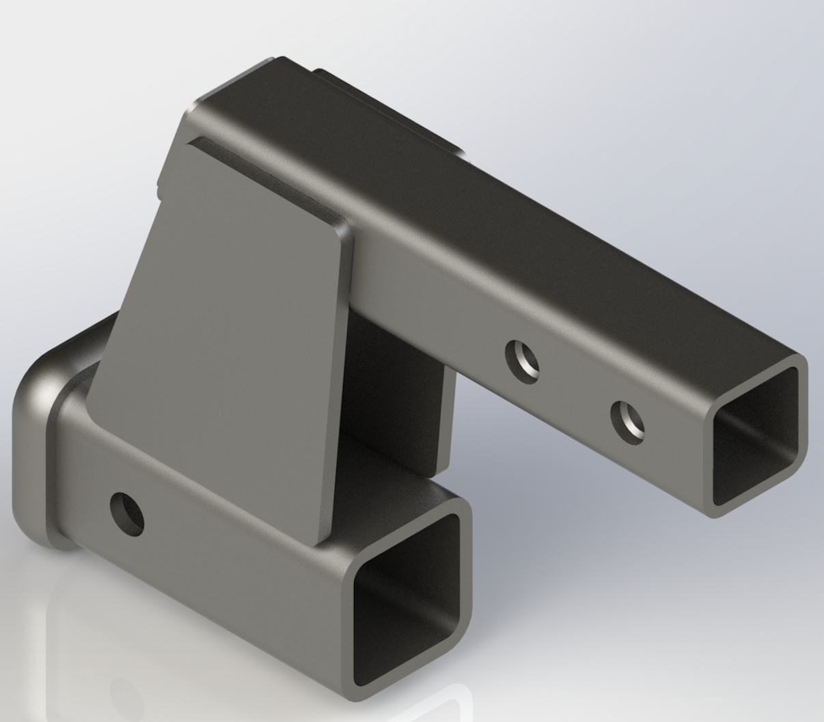
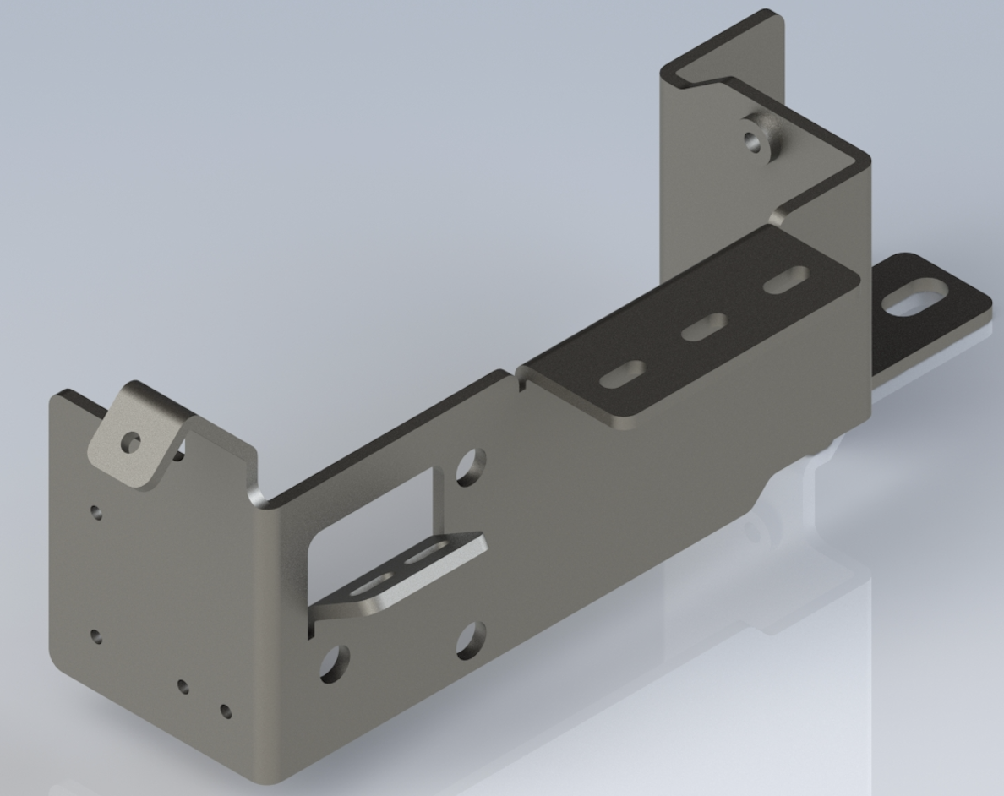
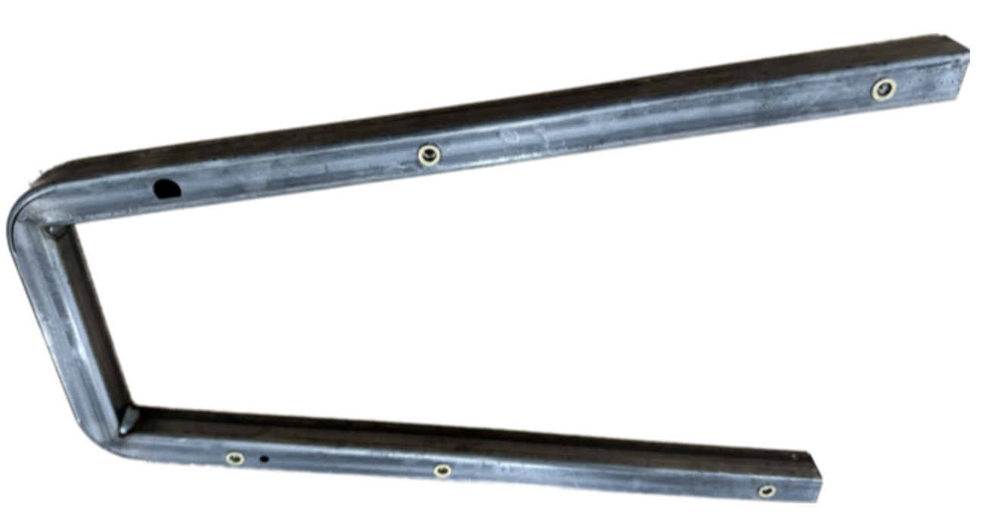
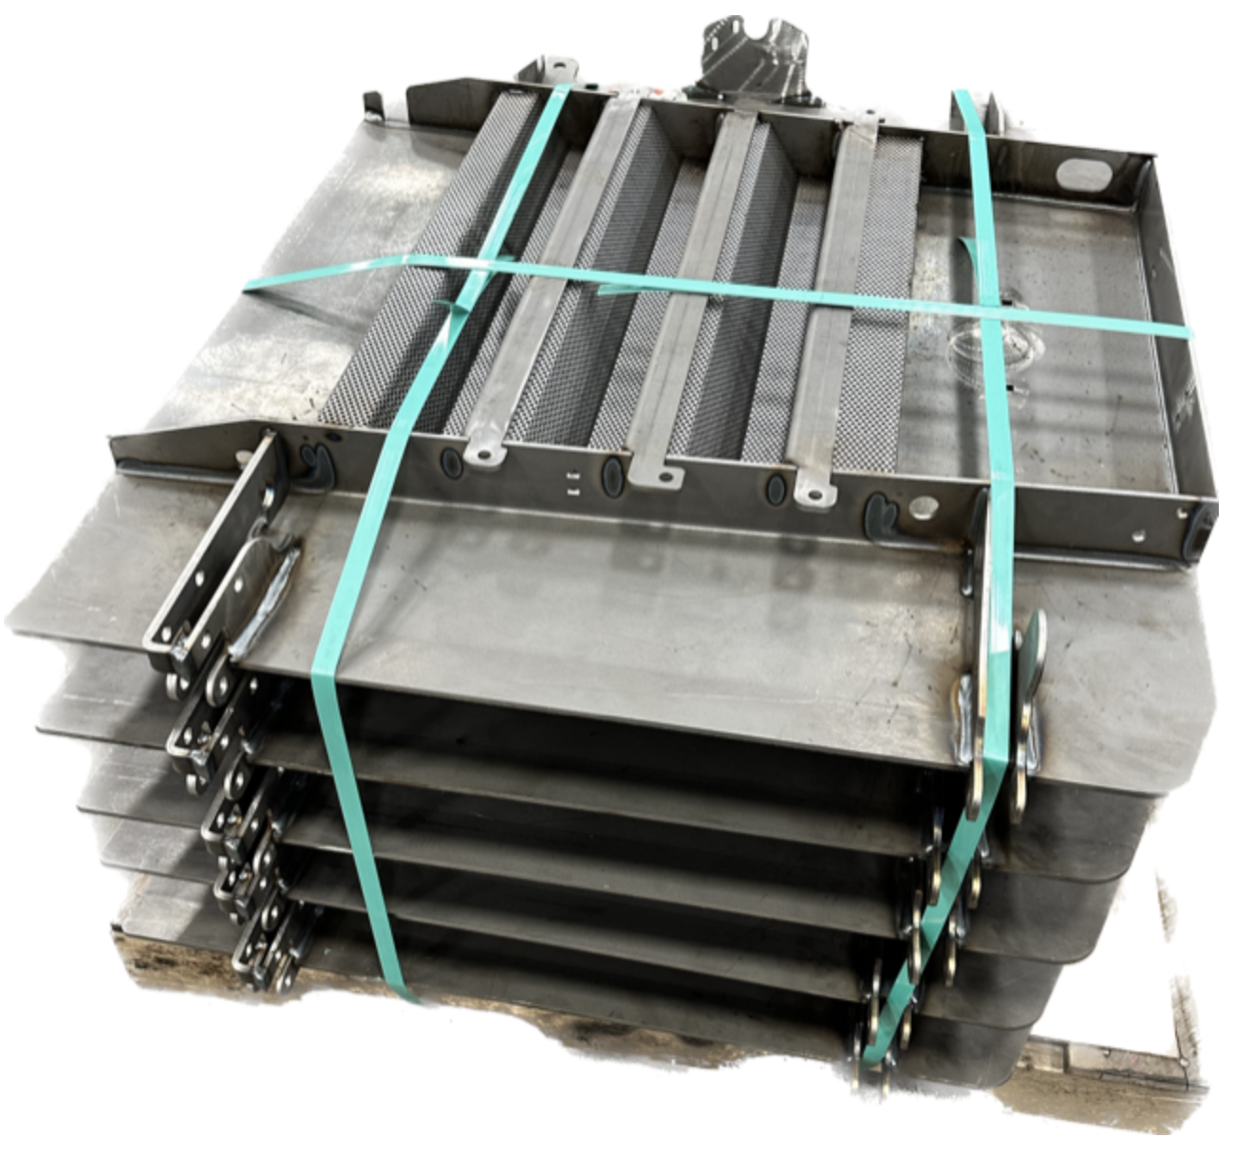
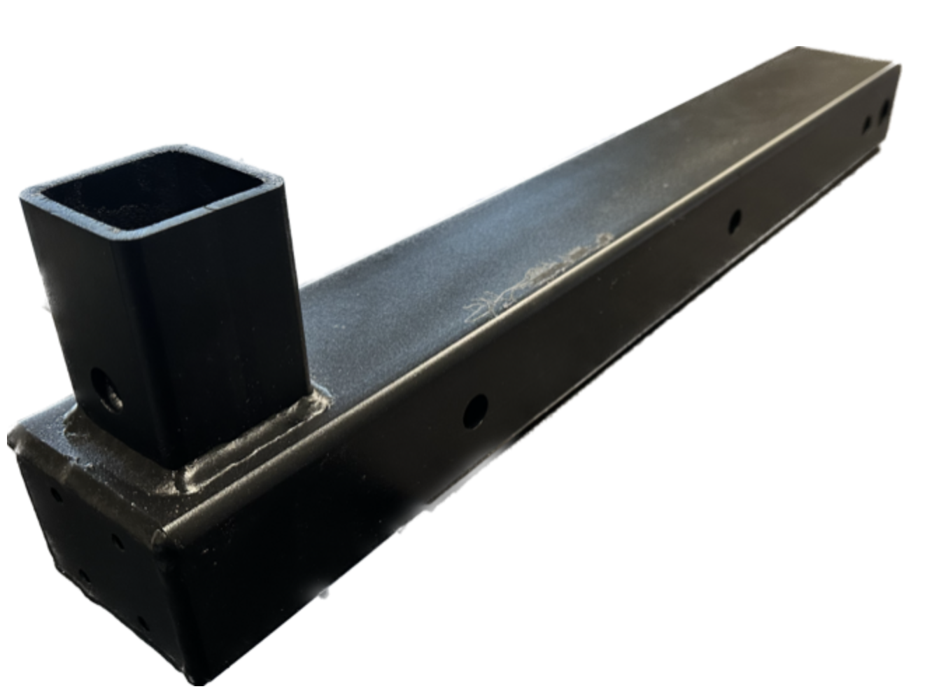
4881 Allen Park Drive
Allendale, MI 49401
P: (616) 892-7070
quote@laserdynamics.com
www.laserdynamics.com
INNOVATION AND INTEGRITY
Laser Dynamics, Inc. is a precision sheet metal fabrication company specializing in Carbon Steel, Stainless Steel and Coated Steel products. We have the resources to build custom prototypes and large production runs.

